Slide 1
Welcome to Hello World Series
How Distributed Version Control Systems work

Slide 2
In last tutorial...
We discussed – How Centralized Version Control Systems work?

Slide 3
In this tutorial...
We will see, How do Distributed Version Control Systems work.

Slide 4




How Distributed Version Control Systems work
Repo

Slide 5
How Distributed Version Control Systems work
In a DVCs, Clients don’t just check out the latest snapshot of the files.
Clients fully mirror the repository.
Repo

Slide 6
How Distributed Version Control Systems work
If any Repo Server dies, any of the client repositories can be
copied back up to the server to restore it.
Repo

Slide 7
How Distributed Version Control Systems work
Every clone is really a full backup of all the data.
Repo

Slide 8
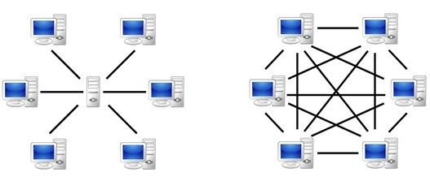
How Distributed Version Control Systems work
Centralized Version
Control Systems
Distributed Version
Control Systems

Slide 9
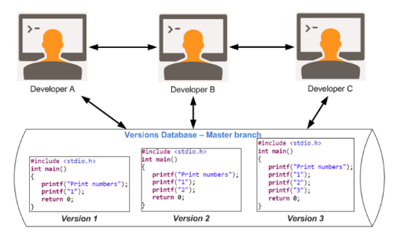
Apply DVCS principle to our example

Slide 10
Coming up Next
Advantages of Distributed Version Control
Notes:
In Slide Show mode, click the arrow to enter the PowerPoint Getting Started Center.

